Slide 1
LESSON 2
BOOK CHAPTER 22
ELECTRIC FIELDS

Slide 2
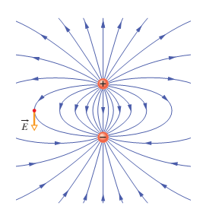


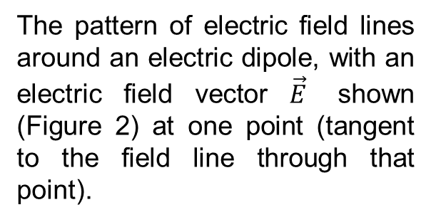
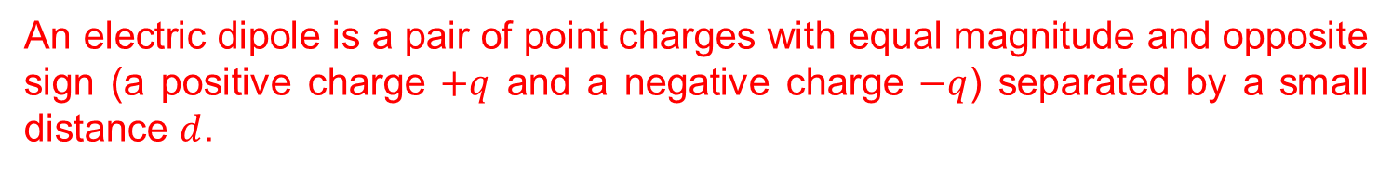
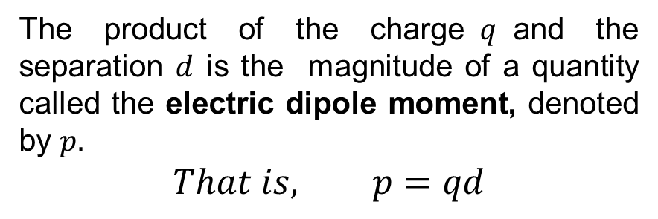


Electric Dipoles:
An electric dipole is a pair of point charges with equal magnitude and opposite sign (a positive charge $+q$ and a negative charge $−q$) separated by a small distance $d$.
Fig.1
$$\vec{d}$$
Fig.2
The product of the charge$q$and the separation $d$ is the magnitude of a quantity called the electric dipole moment, denoted by $p.$
$$That is, p=qd$$
The pattern of electric field lines around an electric dipole, with an electric field vector $\vec{E}$ shown (Figure 2) at one point (tangent to the field line through that point).
In vector form,
$$\vec{p}=q\vec{d}$$
The direction of $\vec{p}$ is from negative charge to
positive charge as shown in figure 1.

Slide 3
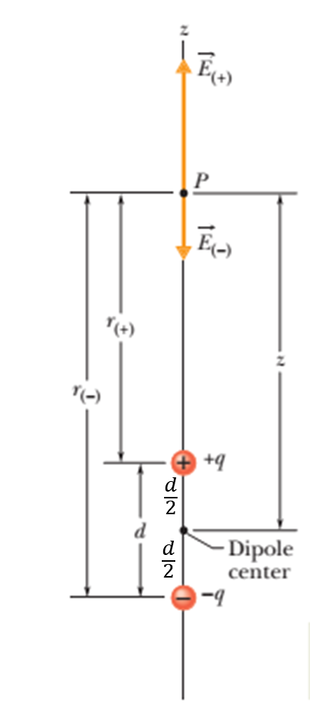
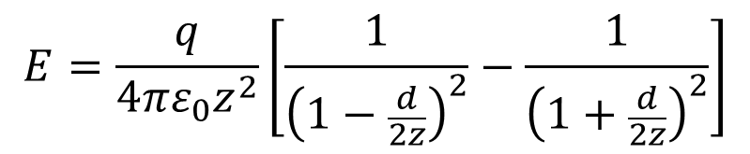

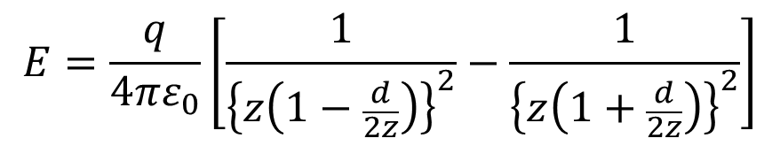
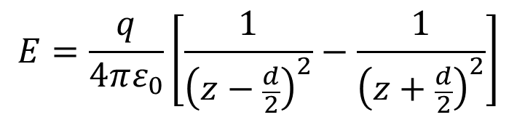
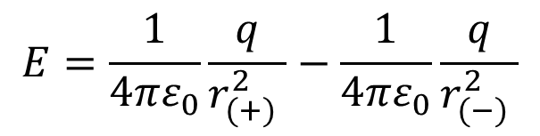
The Electric Field Due to an Electric Dipole:
The net magnitude of the electric field at point P is
$$E=E_{(+)}−E_{(−)}$$
$$E=\frac{1}{4πε_{0}}\frac{q}{r_{(+)}^{2} }−\frac{1}{4πε_{0}}\frac{q}{r_{(−)}^{2} }$$
$$E=\frac{q}{4πε_{0}}\left[\frac{1}{{\left(z−\frac{d}{2}\right)}^{2}}−\frac{1}{{\left(z+\frac{d}{2}\right)}^{2}}\right]$$
$$E=\frac{q}{4πε_{0}}\left[\frac{1}{{\left\{z\left(1−\frac{d}{2z}\right)\right\}}^{2}}−\frac{1}{{\left\{z\left(1+\frac{d}{2z}\right)\right\}}^{2}}\right]$$
$$E=\frac{q}{4πε_{0}z^{2}}\left[\frac{1}{{\left(1−\frac{d}{2z}\right)}^{2}}−\frac{1}{{\left(1+\frac{d}{2z}\right)}^{2}}\right]$$

Slide 4
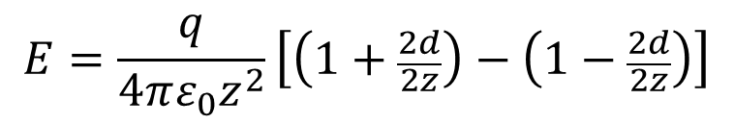


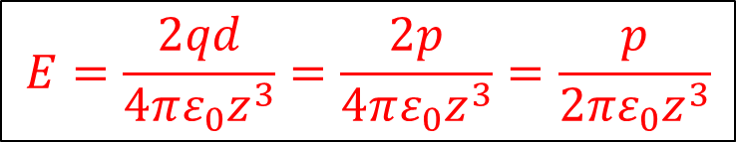
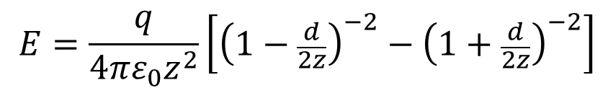



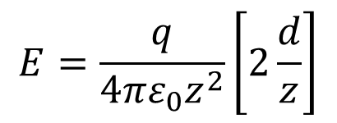

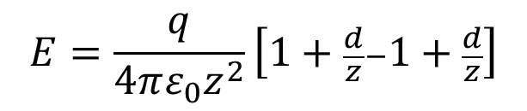
$$E=\frac{q}{4πε_{0}z^{2}}\left[{\left(1−\frac{d}{2z}\right)}^{−2}−{\left(1+\frac{d}{2z}\right)}^{−2}\right]$$
For $z≫d, we have \frac{d}{2z}≪1$
We use the form of binomial theorem,
$$Here \frac{d}{2z}≪1$$
$${\left(1+x\right)}^{n}=1+\frac{nx}{1!}+\frac{n\left(n−1\right)x^{2}}{2!}+ . . . (x^{2}<1)$$
$$Therefore, we can write,$$
${\left(1+x\right)}^{n}≈1+nx for x≪1$
$$E=\frac{q}{4πε_{0}z^{2}}\left[\left(1+\frac{2d}{2z}\right)−\left(1−\frac{2d}{2z}\right)\right]$$
$$E=\frac{q}{4πε_{0}z^{2}}\left[1+\frac{d}{z}−1+\frac{d}{z}\right]$$
$$E=\frac{q}{4πε_{0}z^{2}}\left[2\frac{d}{z}\right]$$
$$E=\frac{2qd}{4πε_{0}z^{3}}=\frac{2p}{4πε_{0}z^{3}}=\frac{p}{2πε_{0}z^{3}}$$
$$Finally,$$
$$here p=qd=electric dipole moment$$

Slide 5
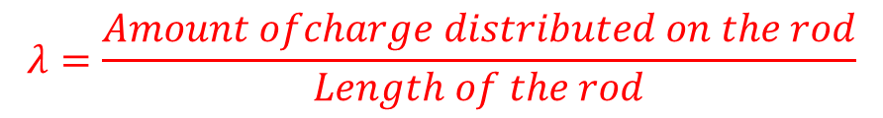
Linear charge density:
When charge is distributed along a line (such as a long, thin, charged plastic rod), we use (the Greek letter lambda λ) to represent the charge per unit length known as linear charge density.
That is
$$λ=\frac{Amount ofcharge distributed on the rod}{Length of the rod}$$
[For uniform linear charge density]
The SI unit of λ is Coulomb/meter;
simply, we use C/m.
Note:

Slide 6
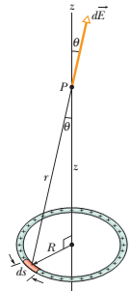
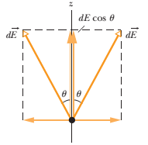
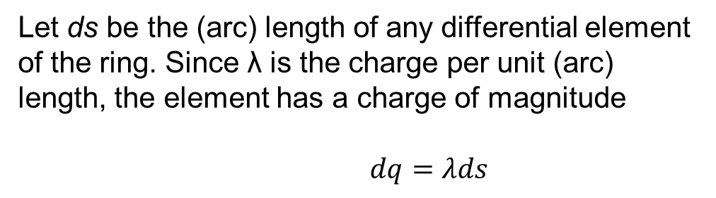
Analytical problem:
For charge that is distributed uniformly over a ring, determine the net electric field at a given point on the axis of the ring (at a distance z from the center of the ring).
Fig. The electric fields set up at P by a charge element and its symmetric
partner (on the opposite side of the ring). The components perpendicular to the z axis cancel; the parallel components add.
Let ds be the (arc) length of any differential element of the ring. Since λ is the charge per unit (arc) length, the element has a charge of magnitude
$dq=λds$

Slide 7
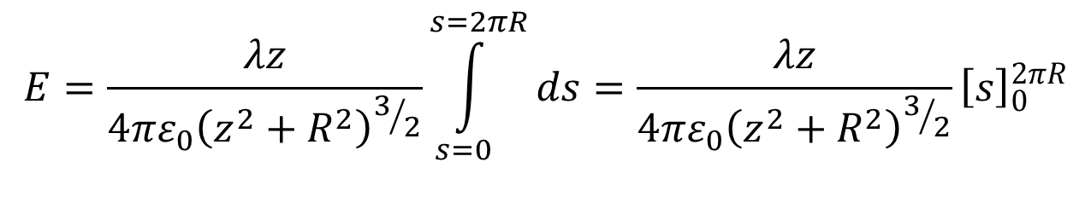

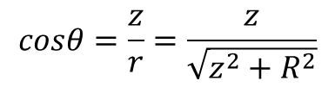
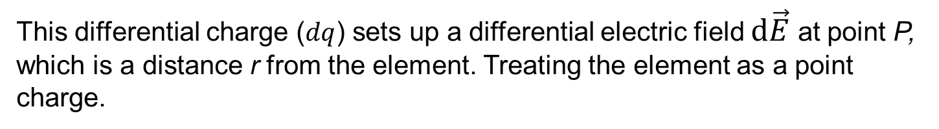

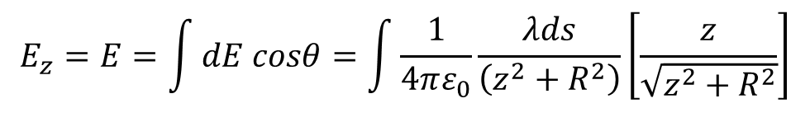
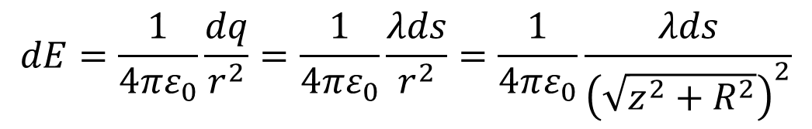
This differential charge ($dq$) sets up a differential electric field $d\vec{E}$ at point P, which is a distance r from the element. Treating the element as a point charge.
Hence, we can write the magnitude of $d\vec{E}$ as
$$dE=\frac{1}{4πε_{0}}\frac{dq}{r^{2}}=\frac{1}{4πε_{0}}\frac{λds}{r^{2}}=\frac{1}{4πε_{0}}\frac{λds}{{\left(\sqrt{z^{2}+R^{2}}\right)}^{2}}$$
Since the components perpendicular to the z axis cancel and the parallel components add, the net electric field along z-axis is
$$From the figure,$$
we can write
$$E_{z}=E=\int{dE cosθ}=\int{\frac{1}{4πε_{0}}\frac{λds}{\left(z^{2}+R^{2}\right)}\left[\frac{z}{\sqrt{z^{2}+R^{2}}}\right]}$$
$$cosθ=\frac{z}{r}=\frac{z}{\sqrt{z^{2}+R^{2}}}$$
$$E=\frac{λz}{4πε_{0}{\left(z^{2}+R^{2}\right)}^{3/2}}\int_{s=0}^{s=2πR}{ds}=\frac{λz}{4πε_{0}{\left(z^{2}+R^{2}\right)}^{3/2}}{\left[s\right]}_{0}^{2πR}$$

Slide 8
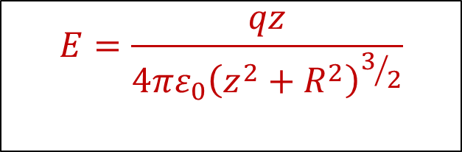
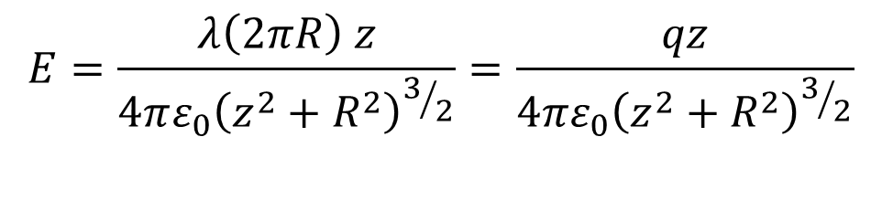
$$E=\frac{λ\left(2πR\right) z}{4πε_{0}{\left(z^{2}+R^{2}\right)}^{3/2}}=\frac{qz}{4πε_{0}{\left(z^{2}+R^{2}\right)}^{3/2}}$$
Finally,
$$E=\frac{qz}{4πε_{0}{\left(z^{2}+R^{2}\right)}^{3/2}}$$

Slide 9
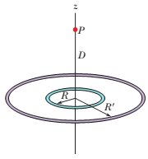
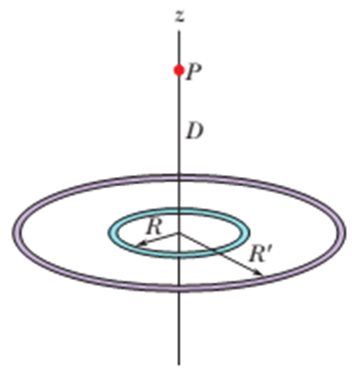

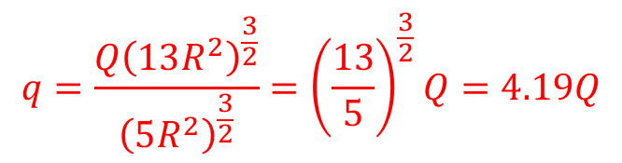
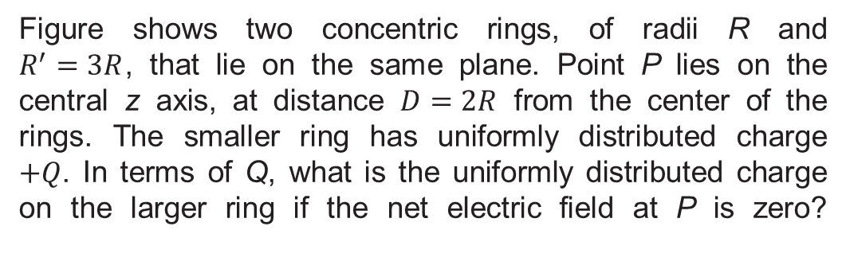

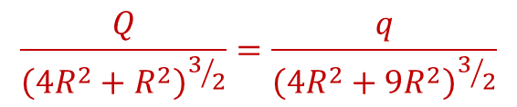

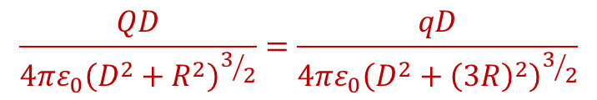




Problem 30 (Book chapter 22)
Figure shows two concentric rings, of radii R and $R^{′}=3R$, that lie on the same plane. Point P lies on the central z axis, at distance $D=2R$ from the center of the rings. The smaller ring has uniformly distributed charge $+Q$. In terms of Q, what is the uniformly distributed charge on the larger ring if the net electric field at P is zero?
$${\vec{E}}_{+Q}$$
Answer:
According to the statement of the problem,
$${\vec{E}}_{−q}$$
$$E_{+Q}−E_{−q}=0$$
$$+Q$$
$$−q$$
$$E_{+Q}=E_{−q}$$
$$\frac{QD}{4πε_{0}{\left(D^{2}+R^{2}\right)}^{3/2}}=\frac{qD}{4πε_{0}{\left(D^{2}+{\left(3R\right)}^{2}\right)}^{3/2}}$$
$$q=\frac{Q{\left(13R^{2}\right)}^{\frac{3}{2}}}{{\left(5R^{2}\right)}^{\frac{3}{2}}}={\left(\frac{13}{5}\right)}^{\frac{3}{2}}Q=4.19Q$$
$$\frac{Q}{{\left({4R}^{2}+R^{2}\right)}^{3/2}}=\frac{q}{{\left({4R}^{2}+{9R}^{2}\right)}^{3/2}}$$
That is
$$q=−4.19Q$$

Slide 10
THANK YOU

